Slide 1
Exploring Dubai Neighborhood for a potential Expat
Amit Kumar Singh
IBM Data Science Capstone

Slide 2
Business Problem
a) Analyze all the available Neighborhoods in Dubai, UAE
b) Analyze Accommodation Prices in the Neighbor hoods based upon online data available
c) Group Neighborhoods based upon Similarities
d) Suggest Low rent Neighborhoods among similar neighborhoods to facilitate a wise decision

Slide 3
Target Audience
Any Person immigrating to Dubai
Any UAE expat, who is planning to move to a different Neighborhood and wish to analyze Dubai neighborhoods and rent expenses
Any body with interest in Data science, who is trying to learn key concepts of clustering methodology/ Unsupervised Learning with a Python based project

Slide 4
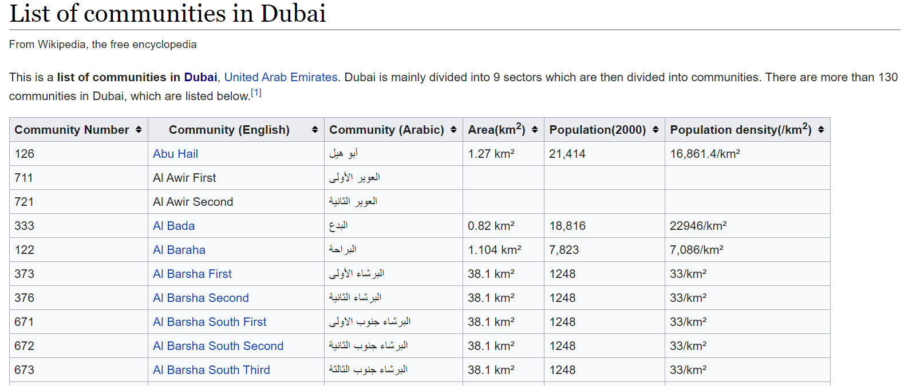
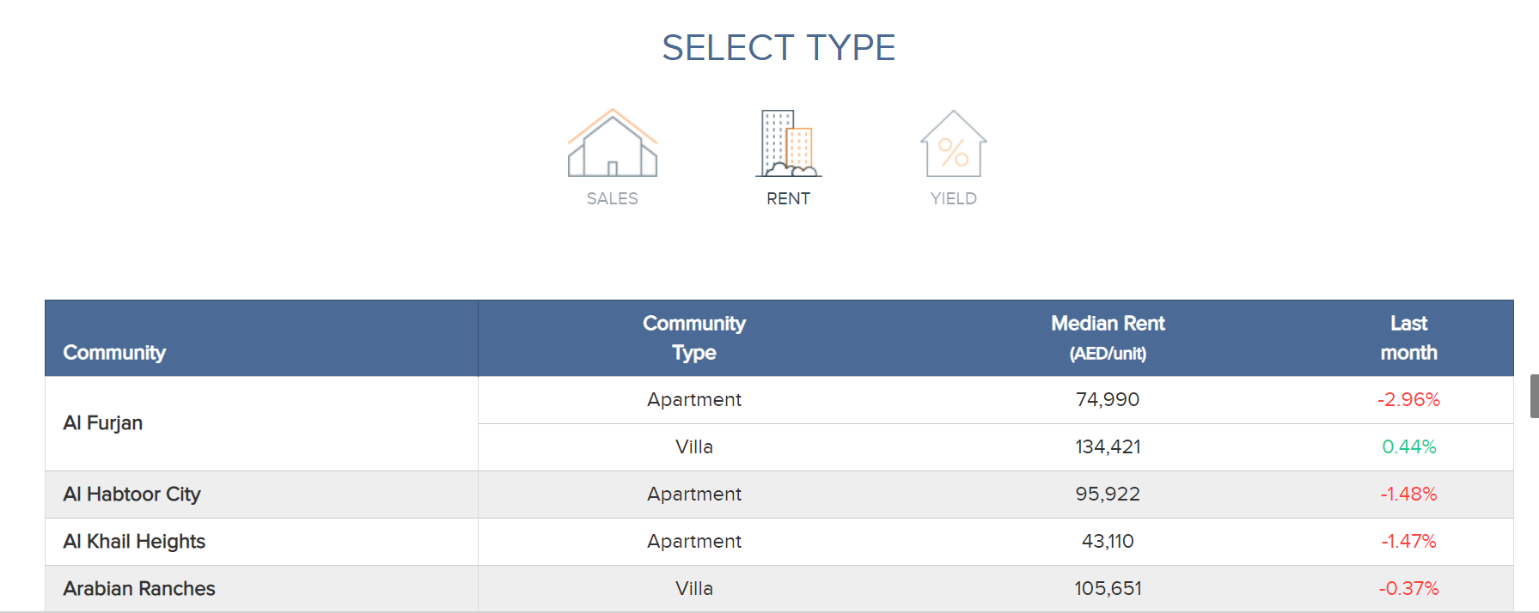
Data Source
https://en.wikipedia.org/wiki/List_of_communities_in_Dubai
https://www.propertymonitor.ae/research/uae-communities-index/dubai-rental-index.html
Foursquare API Data

Slide 5
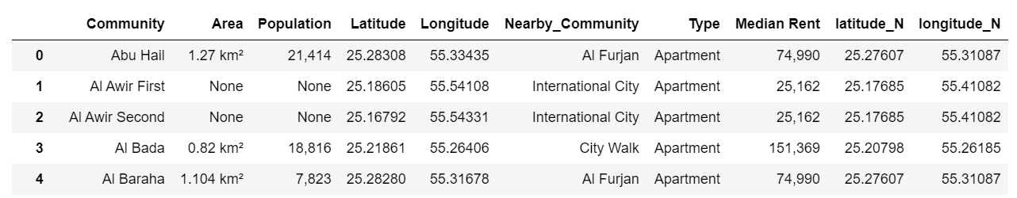
Methodology
Using the Data Source, we will generate a data frame as below.
Community | From Community List in Wikipedia
Area | Community Area
Population | Community Population
Latitude | Coordinates
Longitude | Coordinates
Nearby Community | Nearby Community from Property Monitor
Type | Residence Type
Median rent | Median Rent for Nearby Community
latitude_N, longitude_N | Co Ordinates of nearby Community

Slide 6
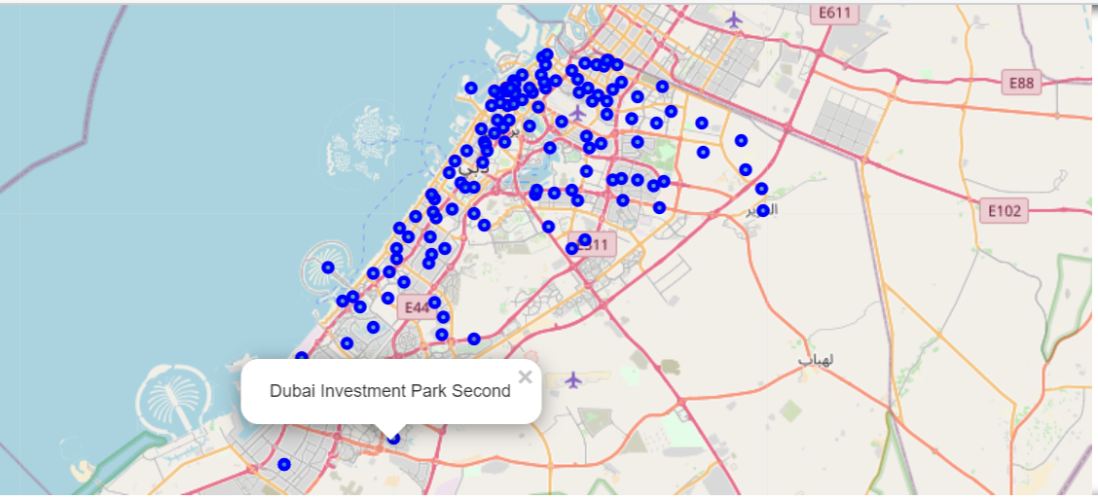
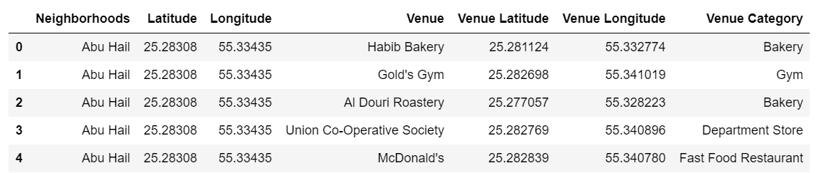
Methodology
Based upon this data a map is generated for all neighborhoods in Dubai with Circle Marker. Clicking on them will provide community name.
List of venues is collected for all neighborhoods by making Foursquare API call.

Slide 7
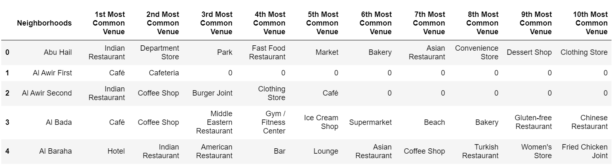
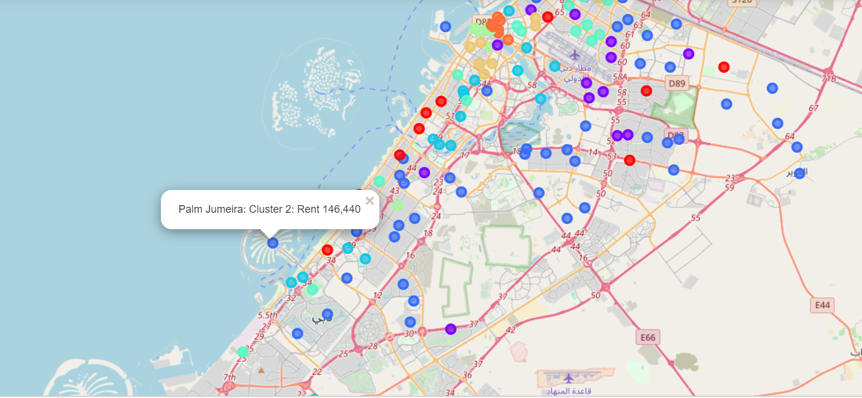
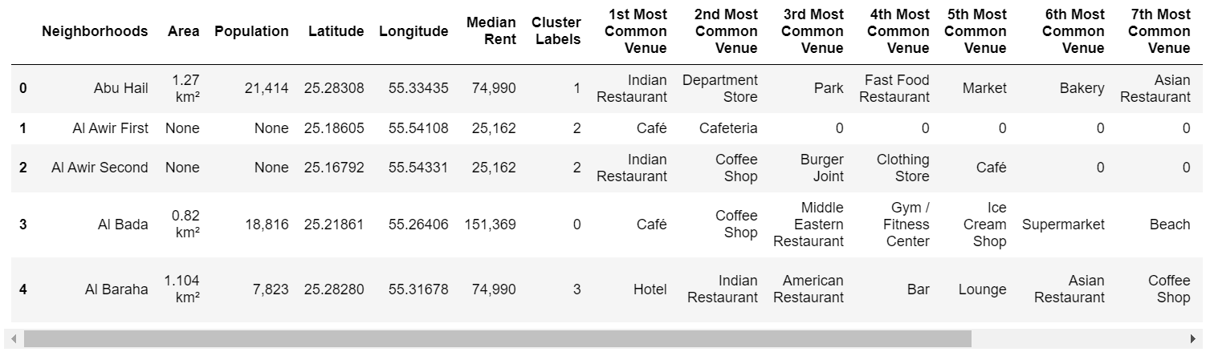
Methodology
Top 10 venue types for each Neighborhood is identified
All Neighborhoods are clustered by similarity in neighborhoods to generate below data frame. Cluster Label shows cluster to which the neighborhood belongs to.
Dubai Map is generated to show cluster, rent details for each neighborhood. All clusters are marked in different color.

Slide 8
Results
We get below clusters using K-Means Clustering.
Cluster 1
Cluster 2

Slide 9
Results
We get below clusters using K-Means Clustering.
Cluster 3

Slide 10
Results
We get below clusters using K-Means Clustering.
Cluster 4
Cluster 5

Slide 11
Results
We get below clusters using K-Means Clustering.
Cluster 6
Cluster 7
Cluster 8

Slide 12
Conclusion
We can have few key conclusions as follows.
a) All clusters have high similarity within it.
E.g. If somebody is coming new to Dubai and looking for hotel accommodation, he will try to look into Cluster 4 neighborhoods. Somebody wanting a relatively calm neighborhood with less venues, may look into cluster 3. Somebody liking multicuisine foods, may consider cluster 7 as it has all different type of Restaurants.
b) Within the cluster based upon venues, an expat can choose neighborhood based upon rent viability.
c) We can also see population density by considering Area and Neighborhood and decide based upon our liking.

